Slide 1

TRIALX.COM

Slide 2
Organizational Onboarding - 2
COMMUNICATIONS

Slide 3
Communication Tools (Remote Medium)
Hipchat
Gotomeeting
Email

Slide 4
HIPCHAT
Internal Communication Tool
<PROJECT ROOM> = has a team - people all around the globe
Everything that is happening on the project.
WHAT HAPPENED
@all: <what I did> | what I was stuck on | this was a challenging problem that I hacked by this way.
Next @all: still working on problem - @yasen @chintan can you look to - can do pair on it.
Ask for help
Show everyone
Feeling of accomplishment. Bonus evaluation. Dev of Month
WHAT DID NOT HAPPEN
WHAT IS SUPPOSED TO HAPPEN

Slide 5
Found/Learning something interesting/found interesting - SHARE with the team on DAILY STANDUP ROOM
E.g. new git commands. “Checkout <link> - with Redux architecture it changes how we do web development - the front end declaratively links to API and UI updates itself.
Dockers are like light VMs that run inside a process on the OS
WE can store location sensor data locally and then sync with server- iOS does not let background sync…
zsh - why use.. ggp
Notification
You might get an offline notification then you forget about it
Email (while you were away)
Mobile
And you are not clear what is supposed to be done.
DO NOT WAIT till the source of message is online to clarify. REPLY INSTANTLY.

Slide 6
Hipchat
online
@owais X, Y, Z to be done
A
offline
offline
B
online
Look at your rooms, email with missed notifications and REPLY instantly
This guy gets
a push message -
can respond instantly

Slide 7
GOTOMEETING
Name on GTM
<First Name> <Last Name>
Always mute if not speaking
Audio Call
Use Phone for Audio
Rule - Test SPEED (speedtest.net) select a US server - before getting an on GTM CLIENT Call
You know that it is low - then use Phone Audio right from start
Screenshare
Client Calls - close hipchat, skype before the call
During a BIG DEMO/Webinar - if you are sharing screen - and you also need to communicate (hipchat on phone or you a secondary laptop to communicate)
Disconnect your phone from laptop
Invite to share screen - UNTIL you Close Hipchat, Skype

Slide 8
GOTOMEETING
Team Calls
Doing dev and its running on localhost - join the GTM from those dev laptops (if more than one) before the CALL
Pause
During the demo/call - you need to go to your email to find something. Then you come back
Record
Initial Kickoff with client - showing requirement or issues
Self-Improvement
sFTP server to upload [To put a link here]
Try to use the Native client and not chrome based GTM/HTML5 client
Chat
By default it will send to everyone
Select one attendee if you want to send to one person only

Slide 9
EMAIL
Acknowledge Quickly
Email comes: when can we expect xyz to be completed?
Don’t wait to complete the work then send email that it’s done
Reply instantly that it’s gonna take 2 hours.
Dear <xyz>, versus Hi <xyz>,
Dear is for formal - people who you don’t know
Hi is informal once you know them
“Hey” is usually with friends.. once they become your buddies!
Hello,
When doing cold email - system emails (downtime/maintenance) - it can stand alone
xyz
Dear Yaseen? or Dear <Title> Dar
Dear Dr. Dar or Dear Mr Dar <preferred in US>
Dear Ms Dar,
In Medical world, if someone is a “Dr” its important to refer
Put comma after the name,

Slide 10
EMAIL
Short First name (use this after familiarity - if that’s what they prefer)
Nickolas => Nick, Robert => Bob, Stanley = > Stan, Elizabeth = > Beth, Rebbecca = > Becky, Jeffery => Jeff
See what they sign their email with at bottom

Slide 11
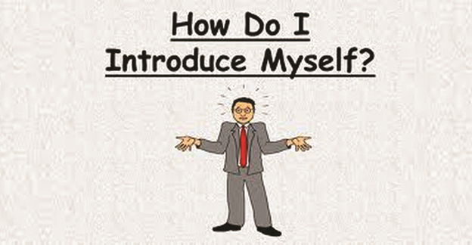

Slide 12
Tips
Business meetings (Round the table introductions) - one or two lines only
Title
Project you are working on
Presentation / Project kick off - know background (so longer intro is allowed)
Educational background
Special skills / expertise (mention some specific expertise/tech if relevant)
Interests
(A personal / humorous line can at times make intro personal. Try it only after ample practice.)

Slide 13
Structure of short introduction:
I am - name
Title at company
Currently leading - eg: lead web & iOS
Structure of long introduction:
I am - name
Title at company -
Currently working with ____ team / project (mention institution names/brand names if applicable)
My background is in -
My interests include -
Can include time/years with /project (as and when required)

Slide 14
Some examples:
Ruzeena Bhat
Hi! I am Ruzeena Bhat. I have joined Applied Informatics as an intern. I was previously working with IBM for a year. My background is in computer science engineering. I love travelling and am a nature lover.
Heena Salem
Hi! I am Heena Salem. I have joined Applied Informatics as an intern. I have completed my computer science engineering. I love surfing the net and also love to travel. I have travelled to Delhi, Mumbai and Karnataka.
Muneer Ashraf
Hi! I am Muneer Ashraf. I am a computer science engineer and have previously worked on data analytics. My final year project was on ‘R’ language. And I love everything that comes my way.

Slide 15
Making a Tx.Edu Presentation

Slide 16
Making a Tx.Edu Presentation

Slide 17
Outline of Talk
Introduce yourself
Present work in 2 / 3 slides
Demo your work
Summarise
Thank everyone

Slide 18
Outline of Presentation slides - Headings under which to classify your work
Project name
Project details ( 2-3 slides)
What is the project about
What is the work that is being presented
How is this work relevant or what are the applications of this work
What is the future plan for this project going forward
Demo
Q and A
Thank everyone - can mention team members

Slide 19
Preparing for your Presentation
Read this: 3 Cardinal Rules to follow Before a Formal Talk / Presentation

Slide 20
How to Write Blogs

Slide 21
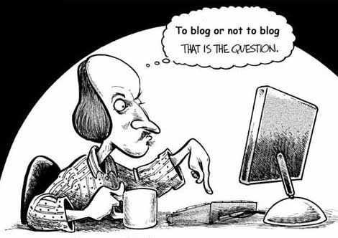
Blogging
Basics

Slide 22
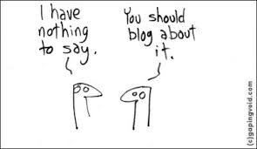

Slide 23
Introduction
BLOG
Body
Closing

Slide 24
Title, Title, Title. Nothing is more important than a well-written title. Grab attention with the headline. The most important thing to remember is that your headline is a promise of value to the reader.
Three powerful headline appeals you can inculcate:
Self-interest - It signals the article will deliver a compelling benefit to the reader
News - It signals the article tells a story that has immediate relevance
Curiosity - It signals the article will answer a question in the mind of the reader (who, what, why, how)
Example:
Title - Brief summary of factors leading to the creation of plaques in coronary arteries: A Heart Disease Review
More optimal Title: Heart Disease Review: Factors leading to Coronary Artery Plaques.
Note: In this case heart disease is right up front because it’s a more searched keyword right upfront. Many search engines only look at the first 65 characters of the title. Hence putting what is most important before helps from SEO perspective. Also from a user's perspective, you immediately recognize that the post is about Heart Disease.

Slide 25
Decide upon 3-4 important keywords to be used in the post. You must decide what is the focus of the article and be able to choose 3-4, maximum 5 keywords that the article is really about. In the example above, one can choose
‘heart disease’
coronary arteries
‘risk factors’ as the three keywords that the article is about. Once you decide your keywords, make sure you use them at-least 3-4 times in the text of the post.
Note: Before you decide your final keywords, it pays to look at Google Keyword tool to see how often that keyword is searched (see Topic on Google Keyword tool)

Slide 26
Open with a bang - People will skim a page for 8-15 seconds to decide if they want to read the whole post.
There are two things your opening paragraph must do to make sure they decide in your favor.
Get to the main point quickly. Let them know where you are taking them in the very first sentence.
Keep it short. A short opening paragraph makes it easier for the reader to commit. A big block of text works like a stop sign for people scanning your page.

Slide 27
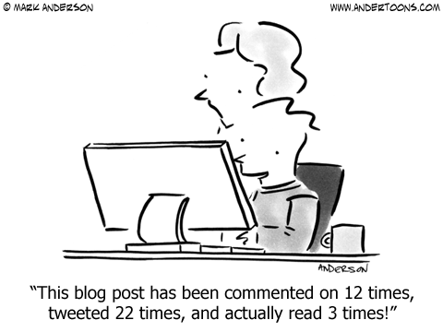

Slide 28
Mark Twain famously said "I didn't have time to write a short letter, so I wrote a long one instead." His point was that writing short involves writing long and editing down.

Slide 29
Write for scanning - This is one of the most overlooked and critical success factors for engaging readers on your blog.
Here are the ways to make blog content more scanning-enabled:
Make sure you have only one idea in a paragraph.
Keep paragraph length to five lines or less. Vary the length of paragraphs to emphasize white space.
Look for ways to break up blocks of copy with subheadings and bulleted lists. White space is as important as the words on the page.
Limit sentence length to 14 words maximum. Vary the length of sentences within the paragraph to give the reader a comfortable rhythm to follow. If you have a long sentence, follow it up with a short one.
Use transition statements to lead the reader from one paragraph to the next. Sometimes these can be short, one-sentence paragraphs that connect the flow of ideas.

Slide 30
Use Descriptive link text. When you add a link to another post, particularly on our site, then the link text is very important. The “link text” is the text that serves as the hyperlink on which people click. Consider this example text given below:
‘Several Infertility Clinical Trials are currently underway.’ In this case “Infertility Clinical trials’ is the “link text”.
Note: It is very common for people to use link text like “Click here”. Such links are not useful from search engine perspective as “click here” means nothing to a search engine. If you have to use the “Click Here” then add a alternate text in the link popup box.
Add Pictures in your Blog. As is well known, a picture is worth a thousand words. A blog with a picture is more engaging than one without. You can reuse pictures that have already been added in previous blogs (using the “media library” or files on your own computer. See detailed instructions on how to add pictures.
Note: Do name the images added descriptively - When you add a picture in your blog, you can set its title, caption etc. to increase its SEO value. Please Give a good image file name, a title and also a caption. Also link back and mention source of your pictures.

Slide 31
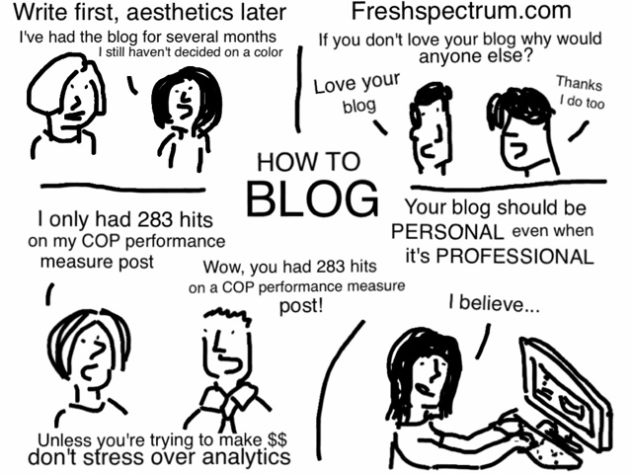

Slide 32
TECHNICAL BLOGS

Slide 33
Pain/Problem
TECHNICAL BLOG
Dream / Plan
Fix / Solution

Slide 34
Article Title - For developers the best titles are those that other developers will be searching for.
Article Introduction - I touched on the introduction previously. The introduction is the second most important part. This is where you inform readers on what to expect and set everything up.
Article Content - Including headings and scannable break points is another important feature. On the web readers quickly scan articles so you need a break to draw them into each section. Some examples are of course headings, blockquotes, lists, and images.
It’s also important to write clearly and keep your style consistent. In technical writing that means keeping your naming the same. A common example is writing the word JavaScript. Don’t mix between using js and JavaScript. Stick with one.

Slide 35
Article Closing - In copywriting the closing is typically your call to action. Most developers aren’t selling anything so this is a great spot to ask for comments, connect via social media, or recap the article.
Wrap up - Now go and write about that problem you solved today. I’m sure it would be a benefit to others.

Slide 36
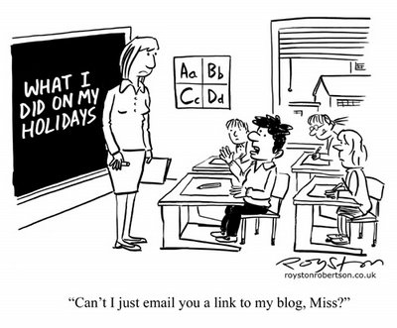

Slide 37
Company Blogs:
Applied Informatics
TrialX
CureTalks
Researchkitapps.org
GetHealth
Blogs to Follow
Huffingtonpost.com
NewYorkTimes Well
Techcrunch.com
The Daily Beast
SearchEngineLand
CricketHighlights

Slide 38
THANK YOU!

